Slide 1
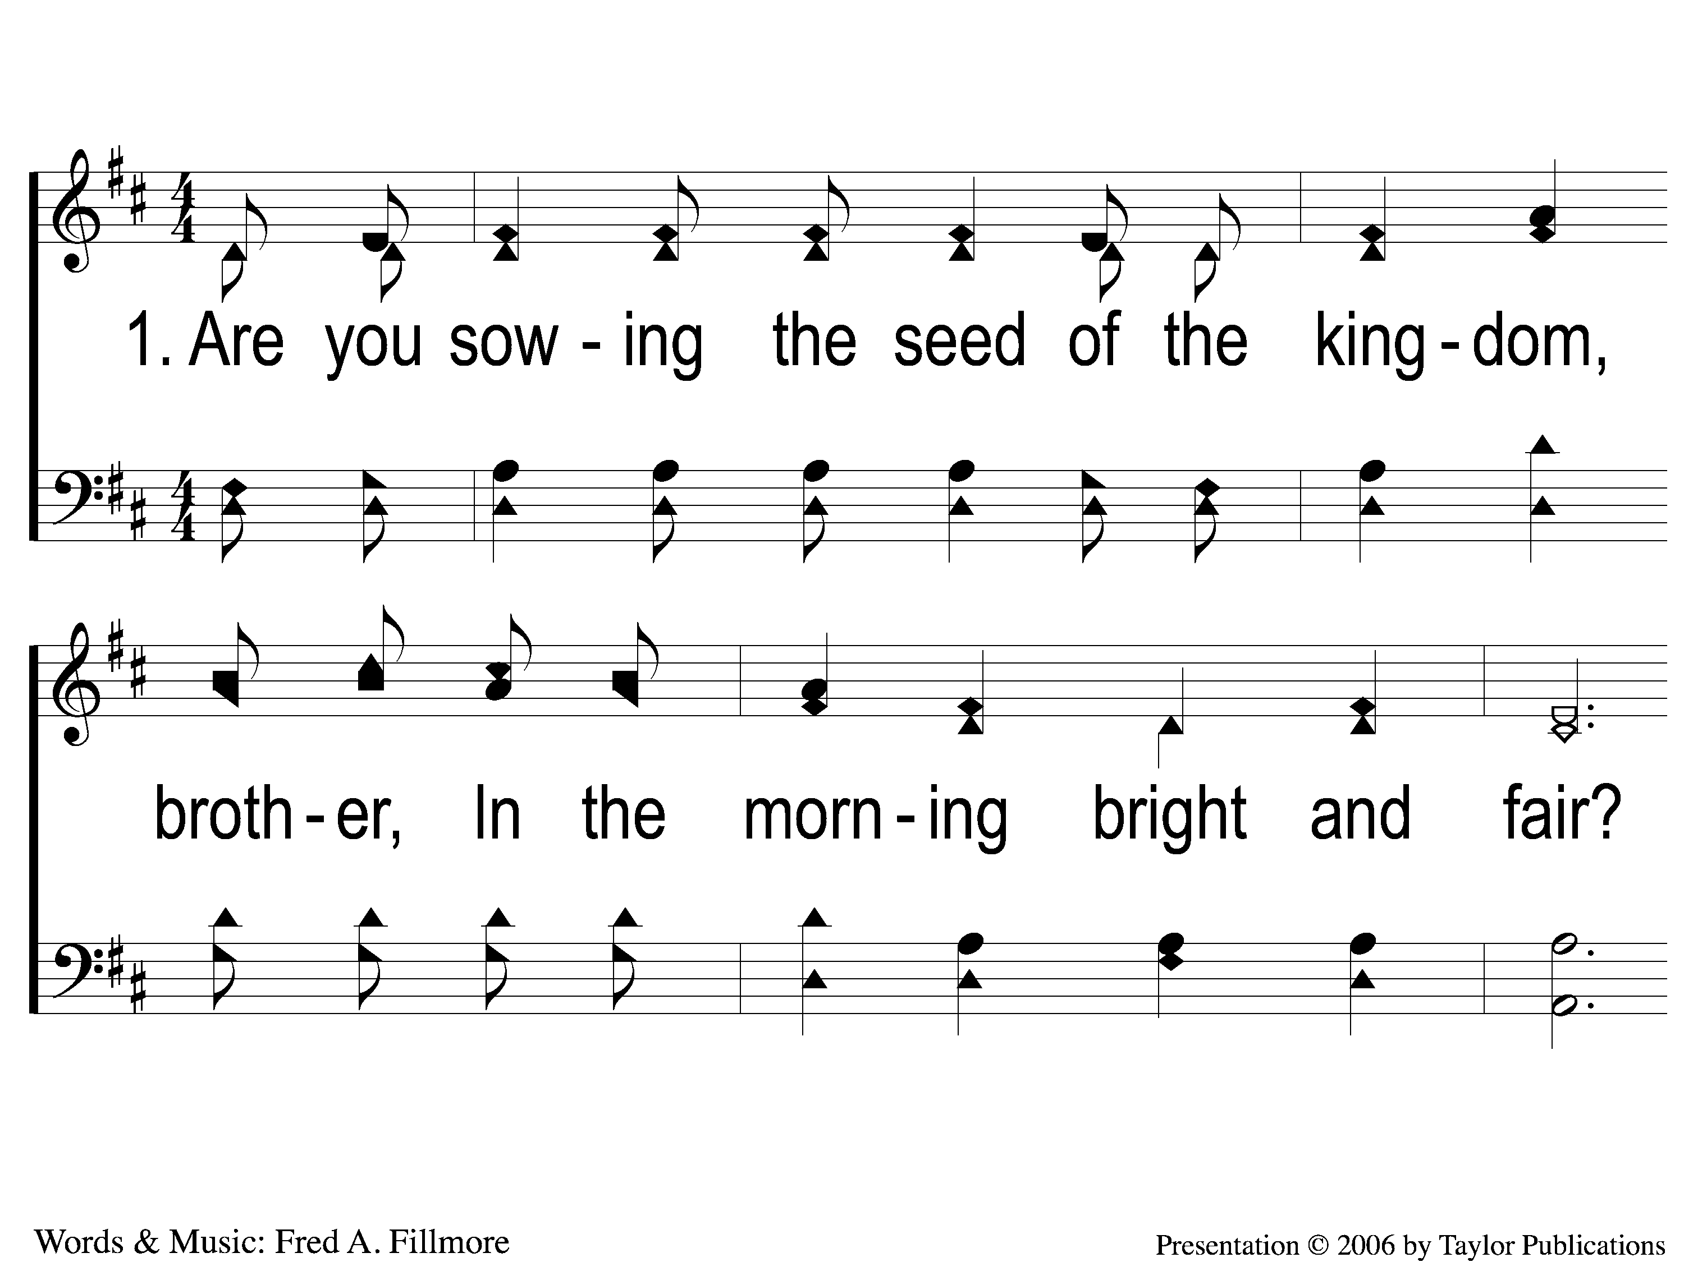
1-1 Sowing the Seed of the Kingdom
Sowing The Seed Of The Kingdom
643

Slide 2
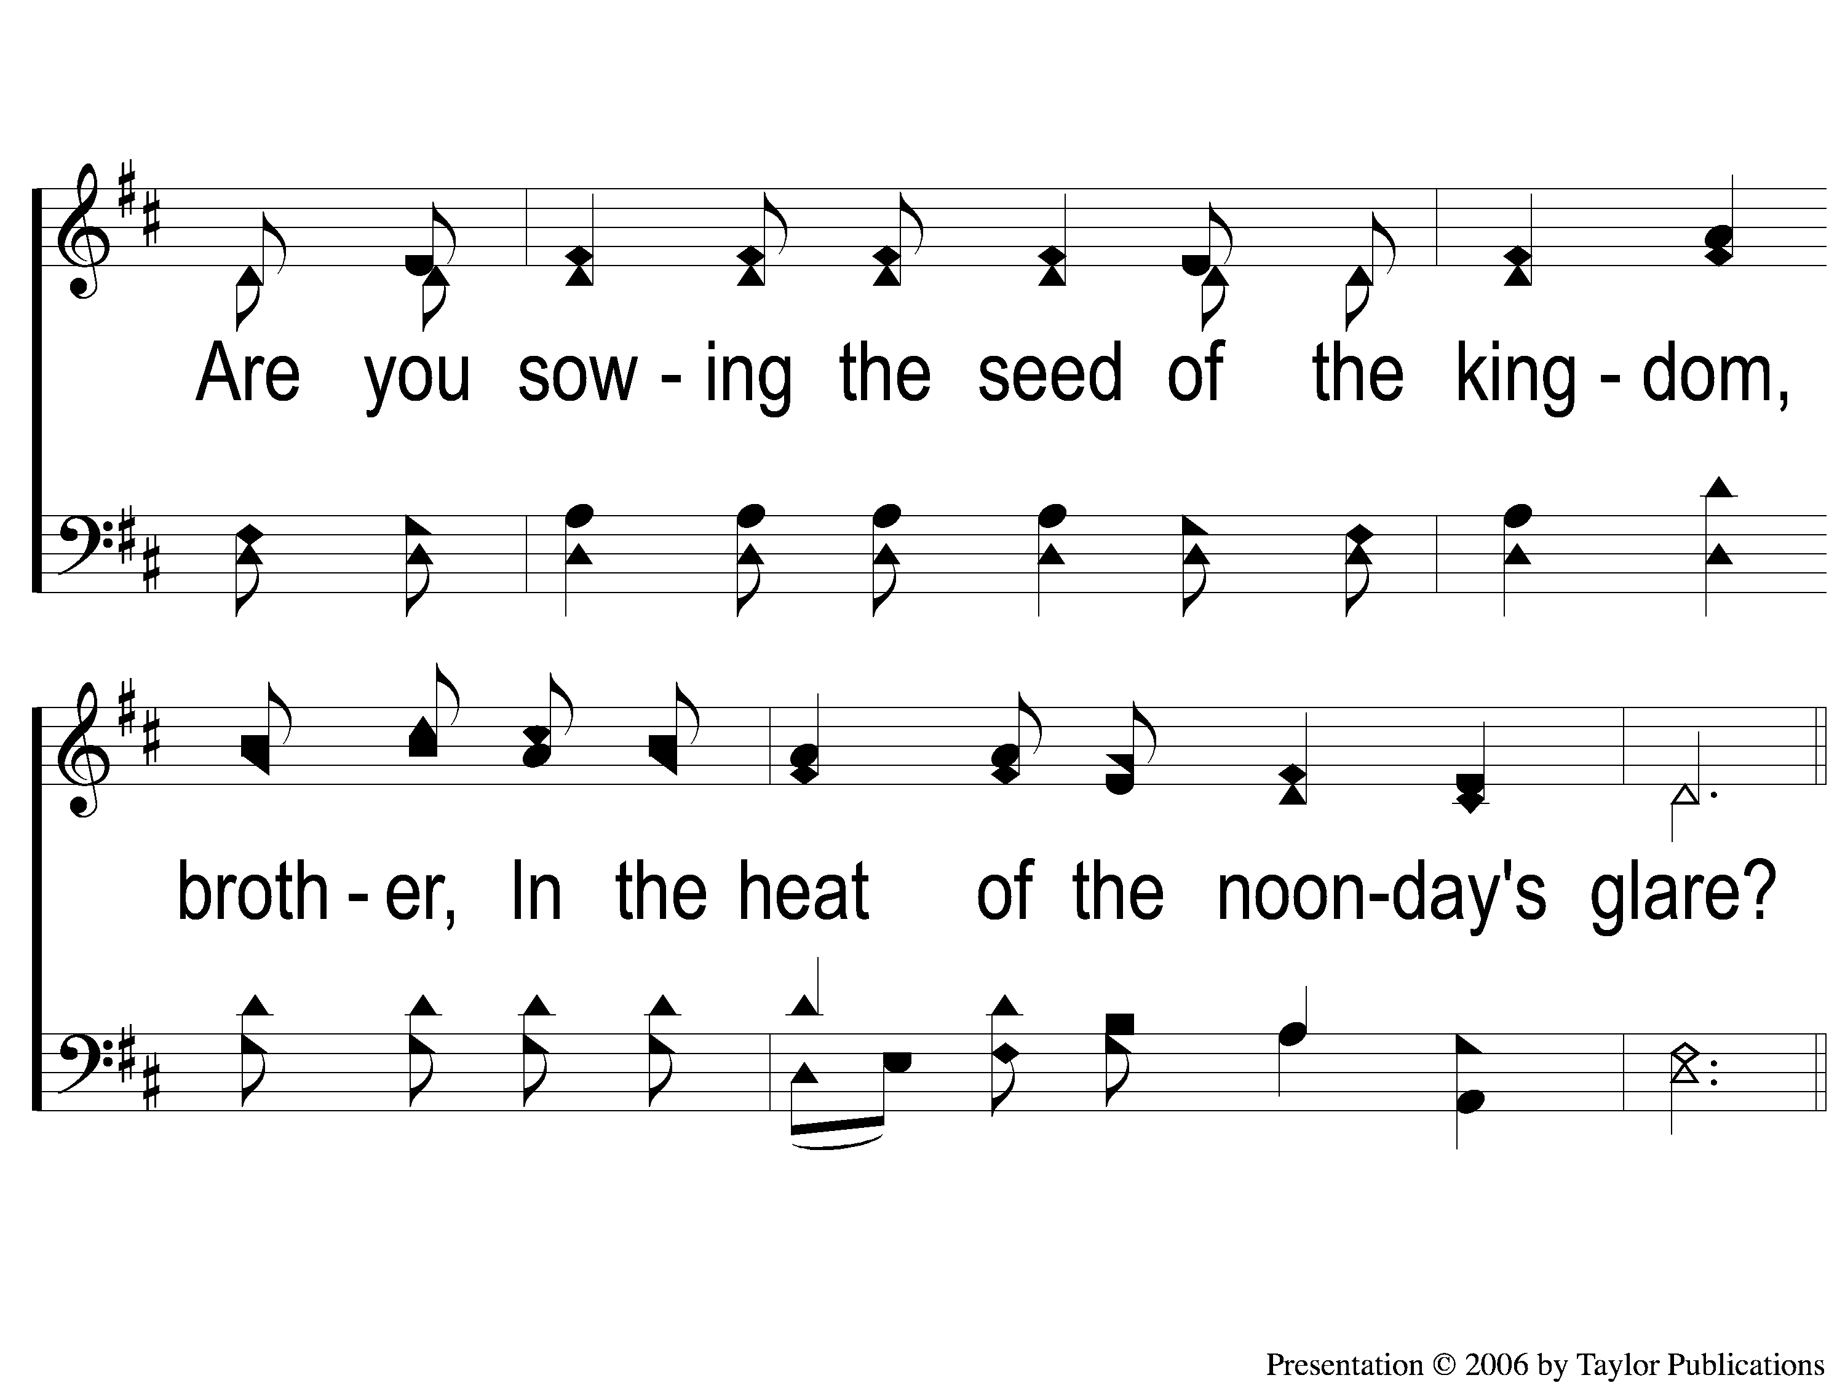
1-2 Sowing the Seed of the Kingdom
Sowing The Seed Of The Kingdom
643

Slide 3
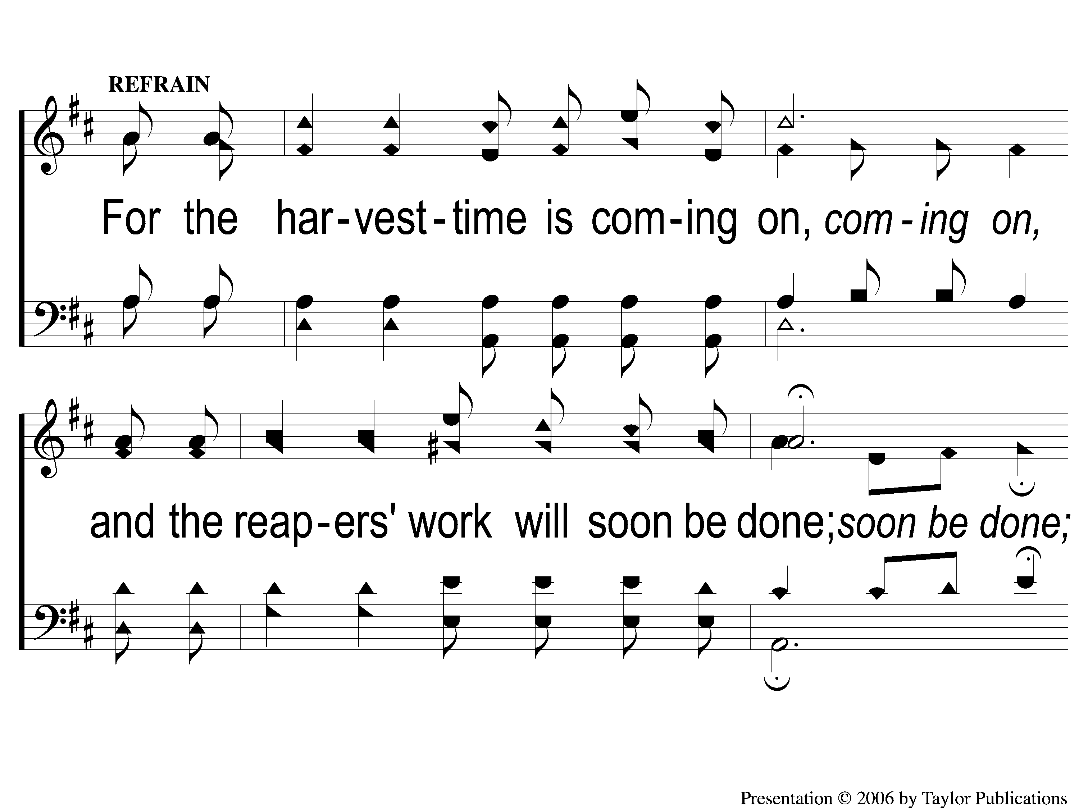
C-1 Sowing the Seed of the Kingdom
Sowing The Seed Of The Kingdom
643

Slide 4
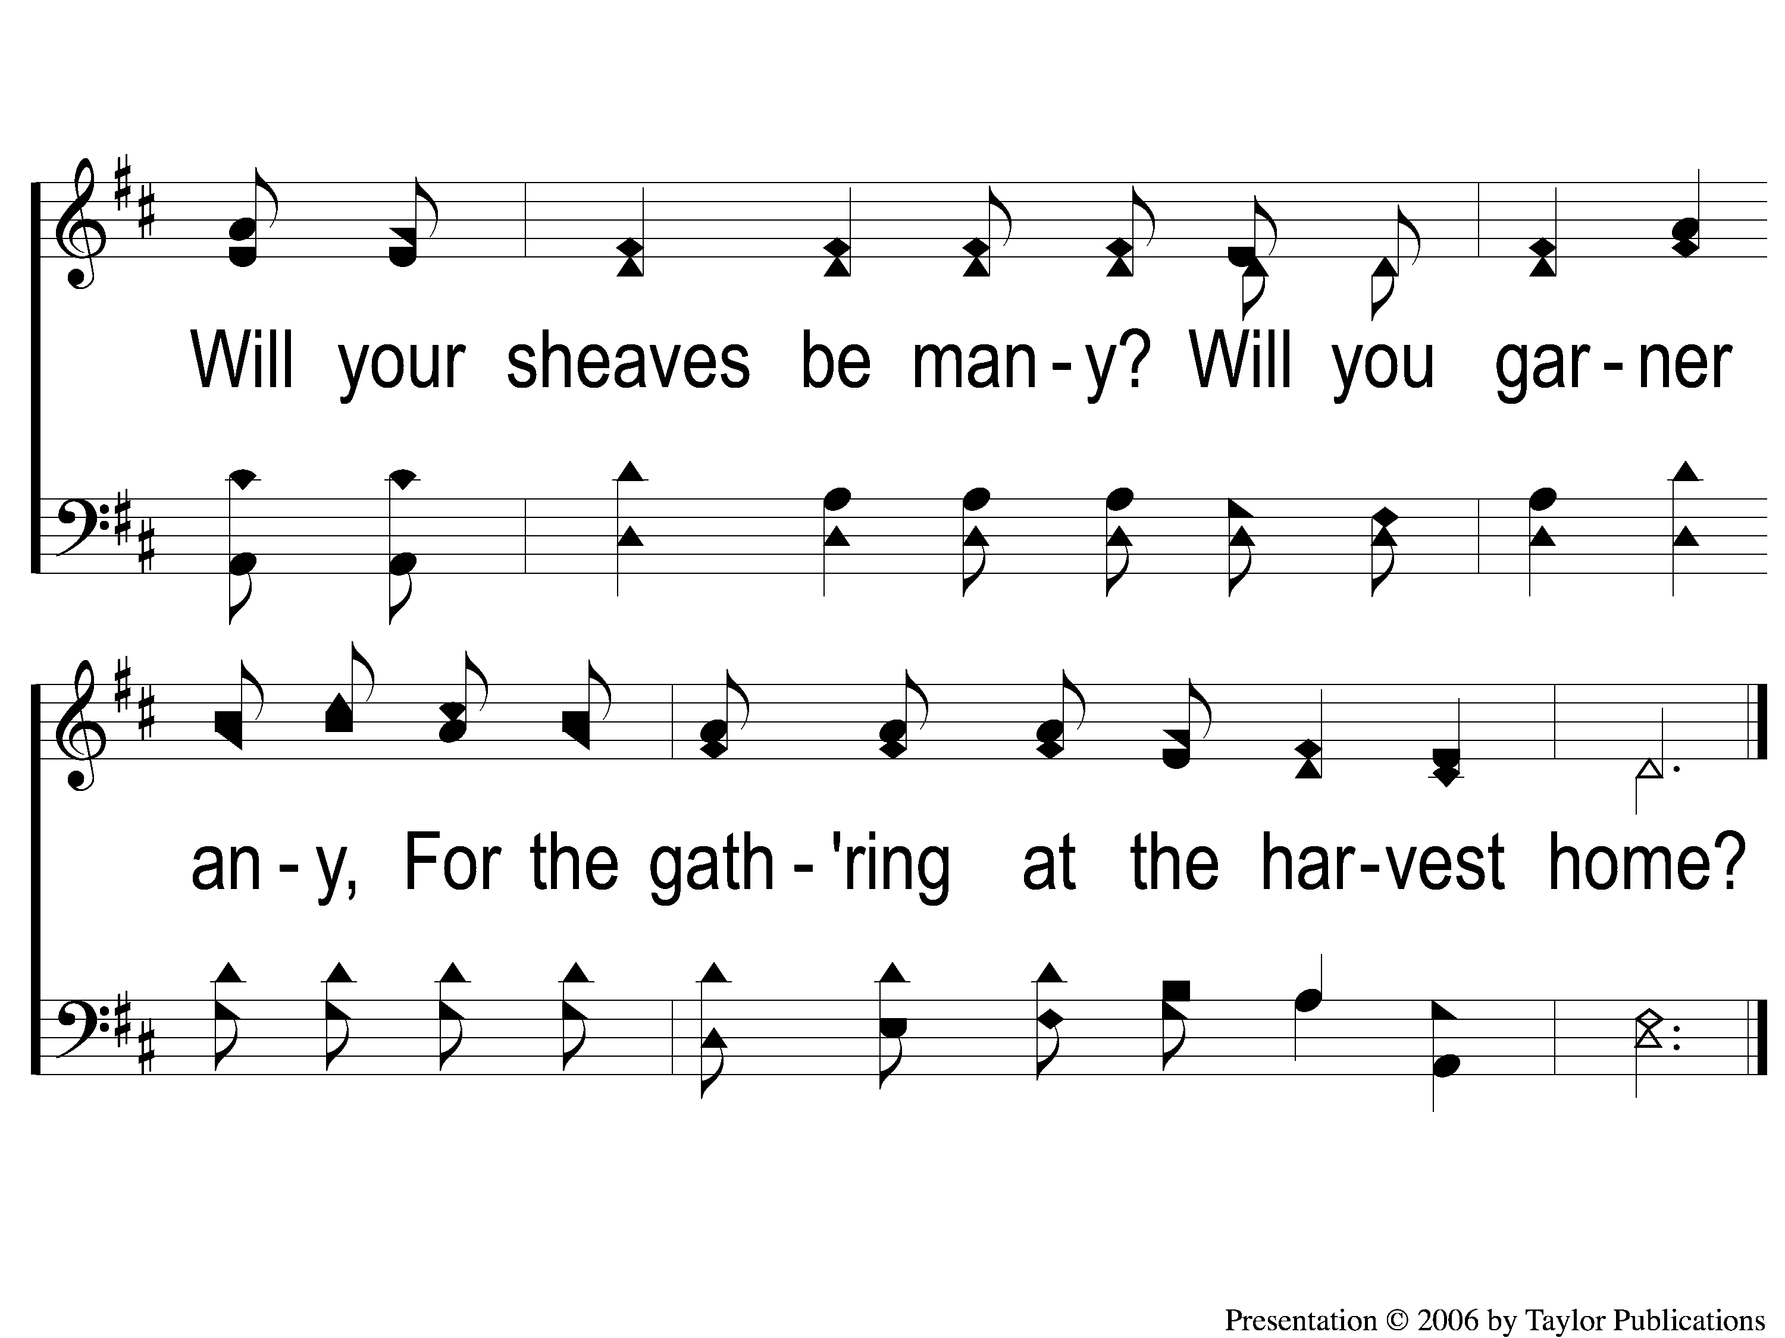
C-2 Sowing the Seed of the Kingdom
Sowing The Seed Of The Kingdom
643

Slide 5
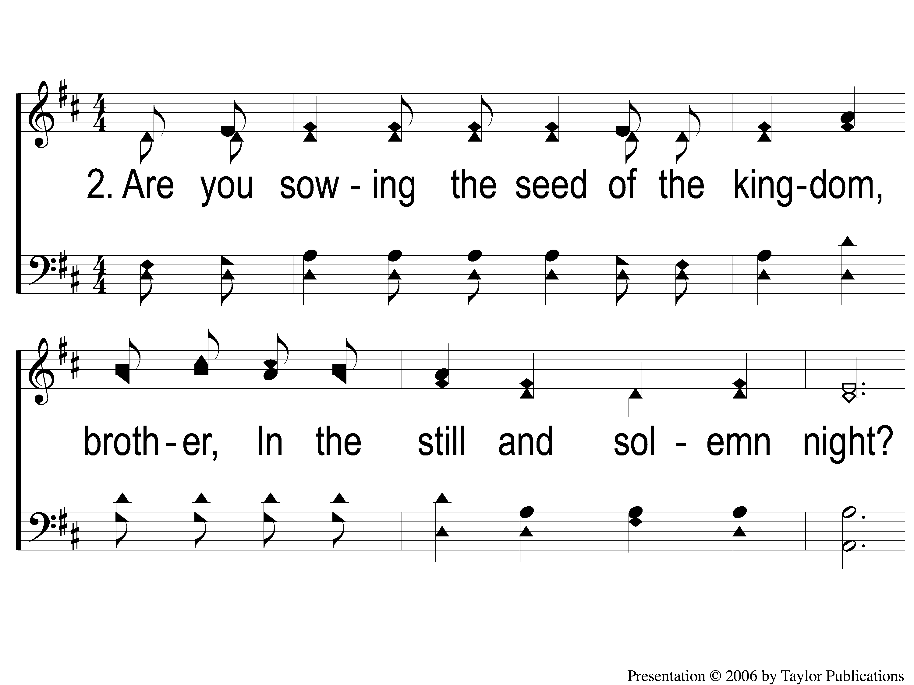
2-1 Sowing the Seed of the Kingdom
Sowing The Seed Of The Kingdom
643

Slide 6
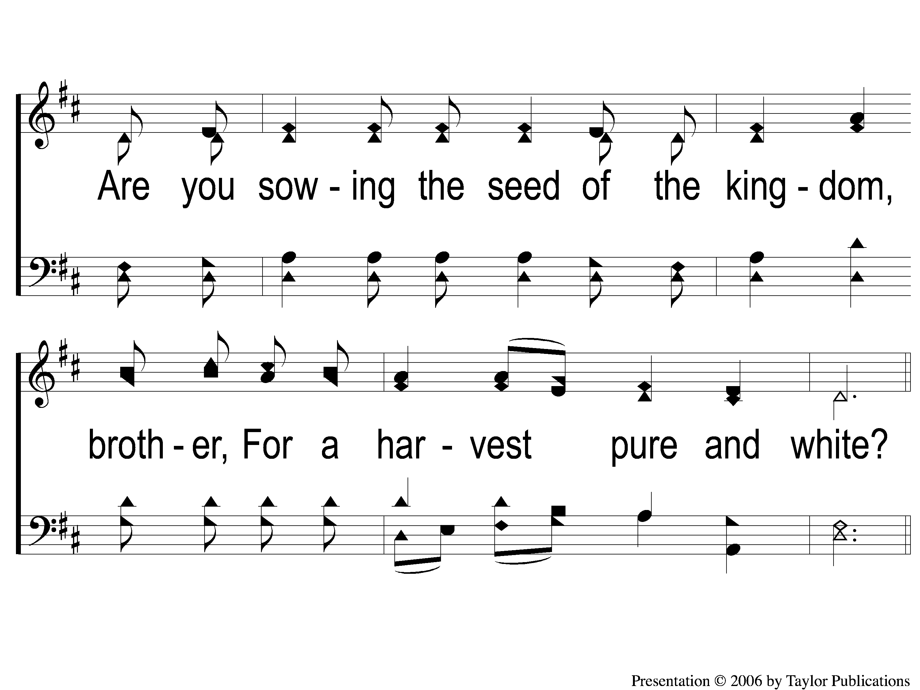
2-2 Sowing the Seed of the Kingdom
Sowing The Seed Of The Kingdom
643

Slide 7
C-1 Sowing the Seed of the Kingdom
Sowing The Seed Of The Kingdom
643

Slide 8
C-2 Sowing the Seed of the Kingdom
Sowing The Seed Of The Kingdom
643

Slide 9
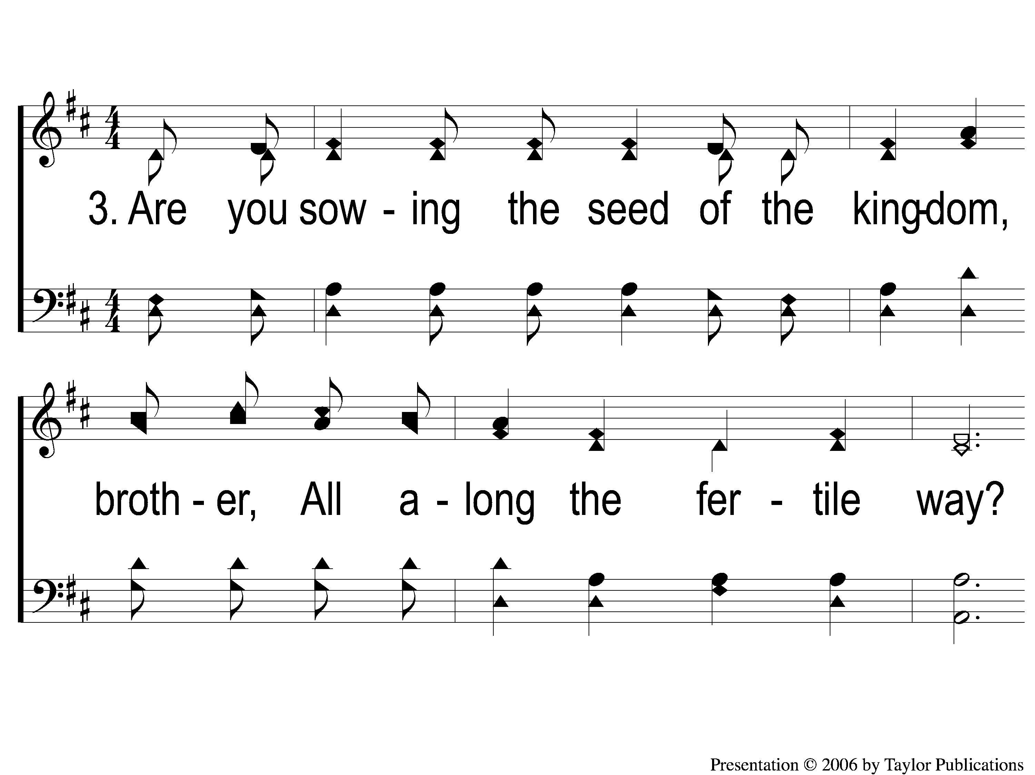
3-1 Sowing the Seed of the Kingdom
Sowing The Seed Of The Kingdom
643

Slide 10
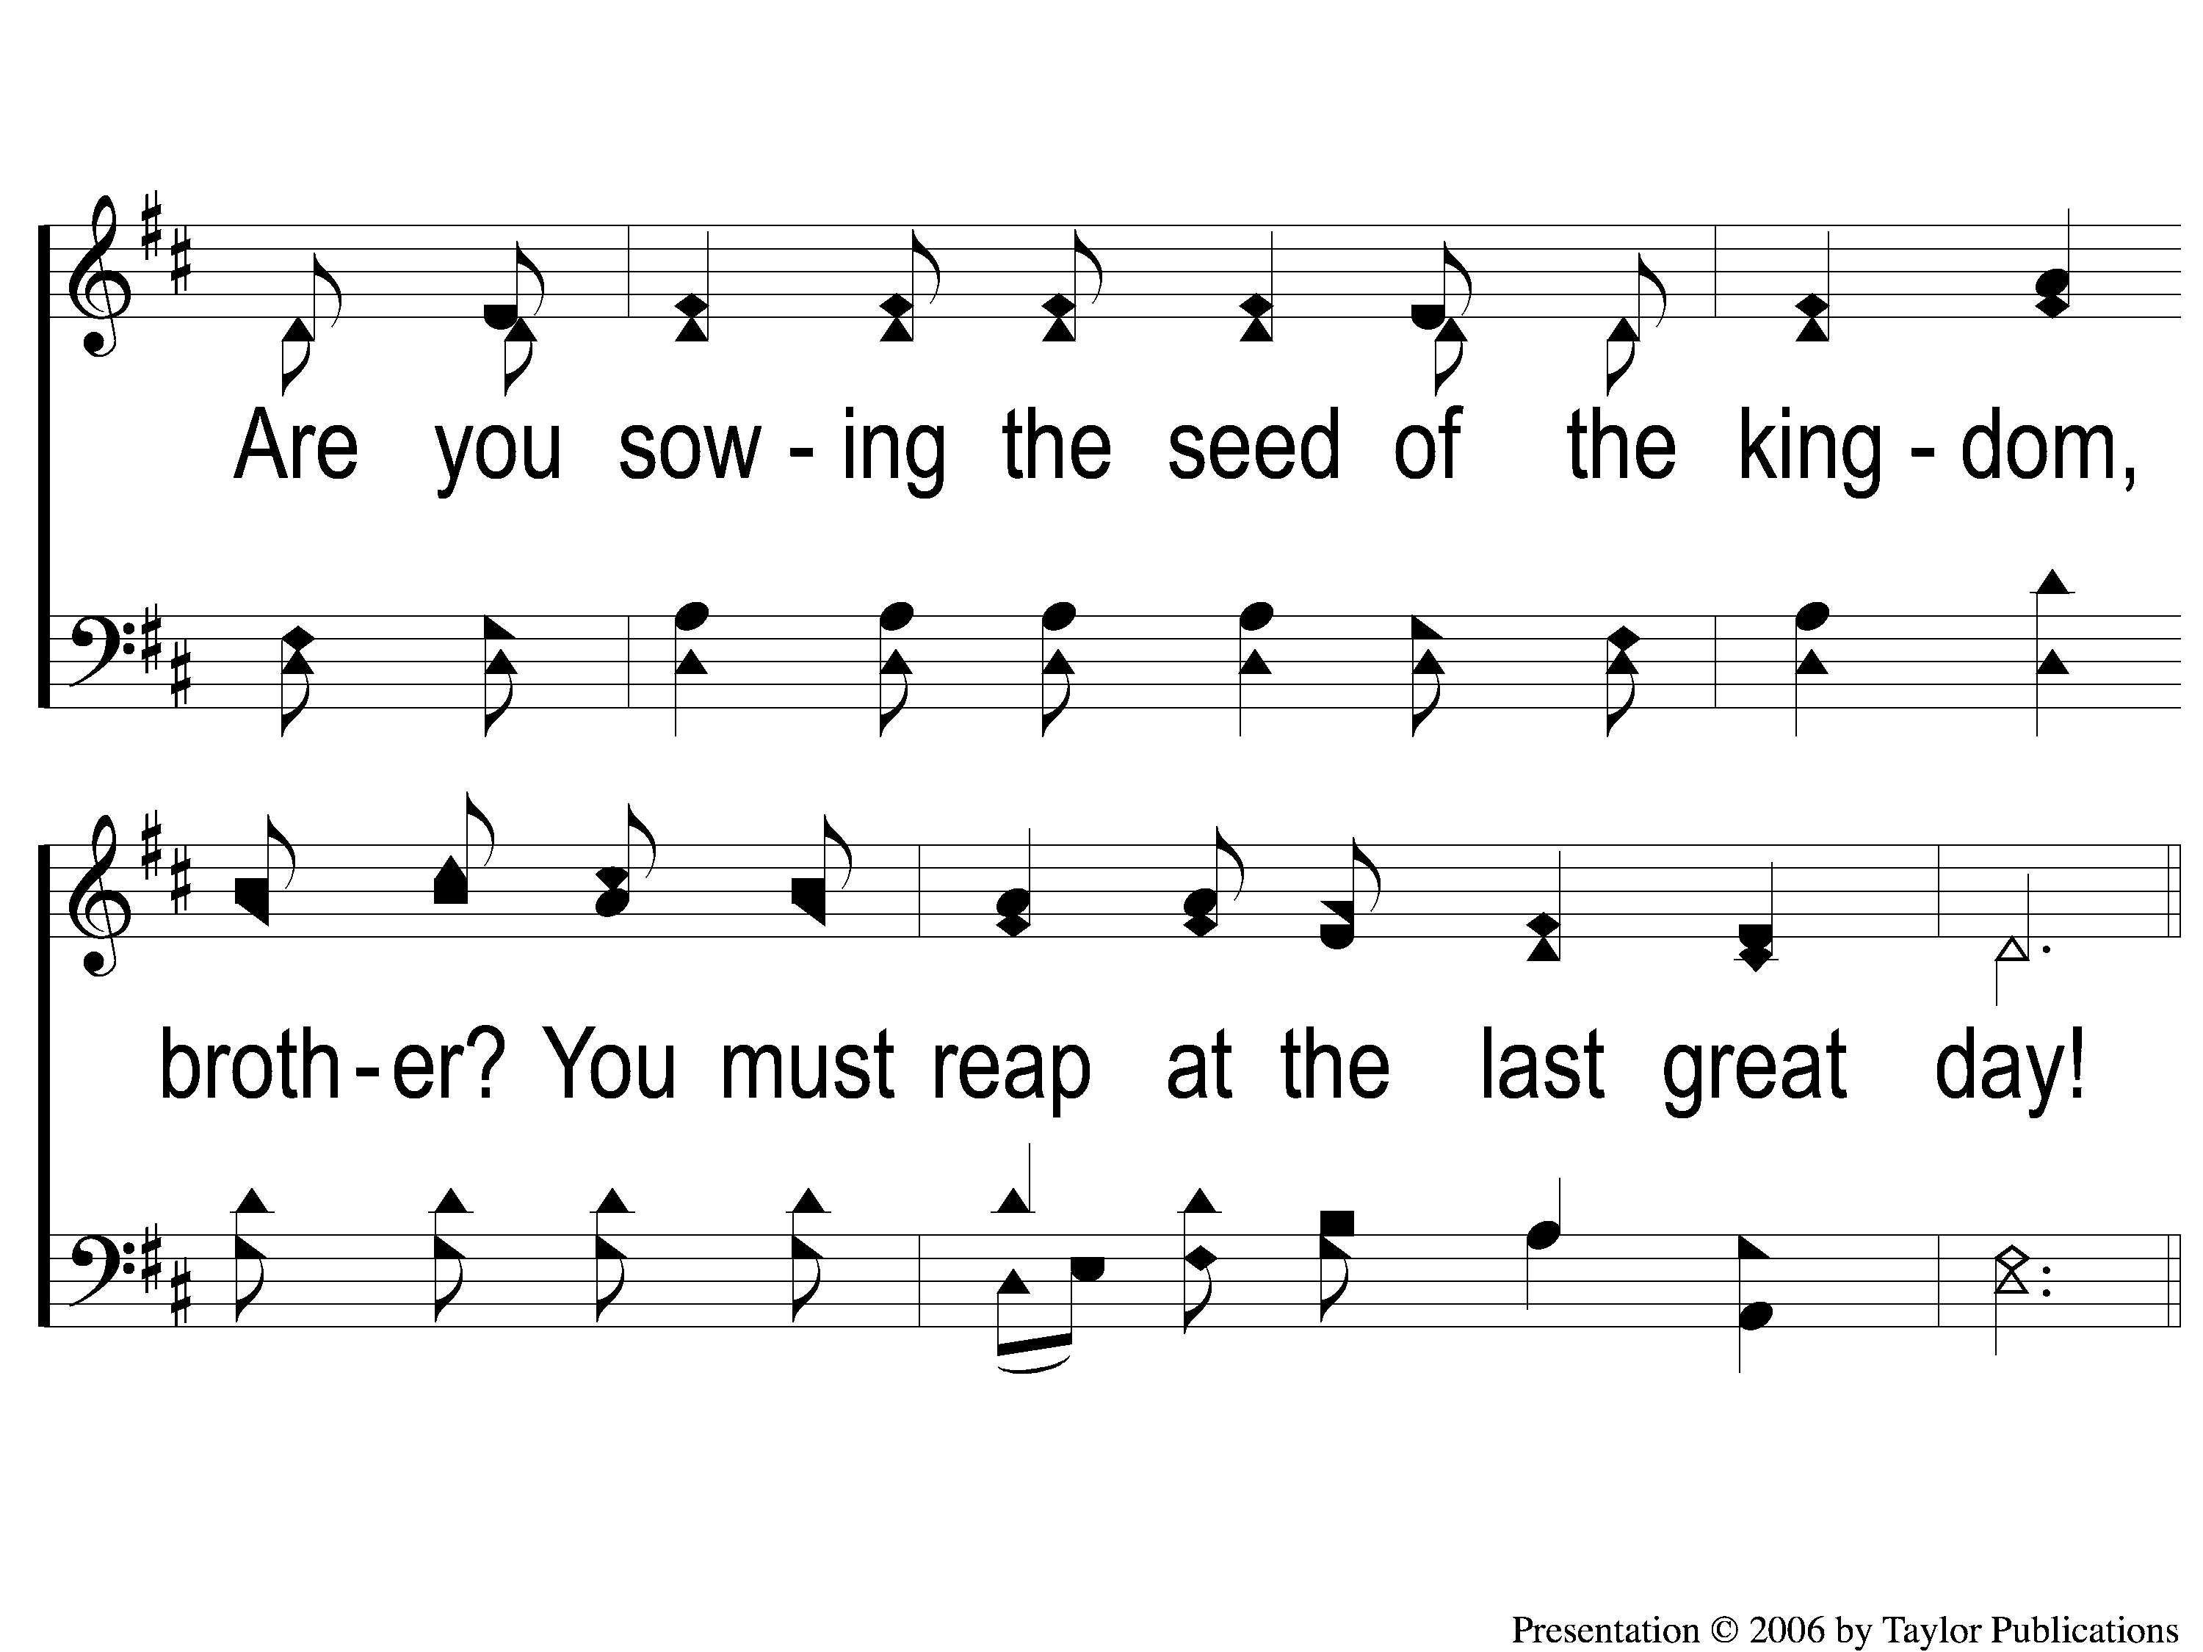
3-2 Sowing the Seed of the Kingdom
Sowing The Seed Of The Kingdom
643

Slide 11
C-1 Sowing the Seed of the Kingdom
Sowing The Seed Of The Kingdom
643

Slide 12
C-2 Sowing the Seed of the Kingdom
Sowing The Seed Of The Kingdom
643

